Slide 1
SOLSTICE & CLT Conference 2016
Dr. Chitra Balakrishna
Senior Lecturer, Edge Hill University
9th & 10th June 2016

Slide 2
The CyberGaTE team
Dr Chitra Balakrishna
Prof Daniela Romano
James Coleman
Michael Banford

Slide 3
Agenda
Need for Change in Cyber Security education
CyberGaTE - Project Aims and Objectives
Why Gamification?
CyberGaTE – Student as Pro-Sumers
Work in Progress
GameJAM
Results

Slide 4
Motivation
Based on two important studies ISACA (2015) and H M Government (2014).
There is a clear shortage of cyber security professionals within UK, while the cyber-threats are on an exponential increase.
Despite the fact that nearly 70% of the 130 Universities in UK offer some form of cyber security courses.
Fresh graduates lack real-world skills that employers demand
Employers value experience more than academic qualifications.
Notes:
The motivation for this project stems from two important studies conducted by ISACA in 2015 and HM in 2014. These studies established certain facts, yes it is true that there is a clear shortage of cyber security professionals within UK while there is a steady increase in cyber threats leaving most of our businesses under-prepared and more vulnerable to threats. This despite the fact that there have been a steady increase in number of cyber security related courses being offerd at various universities across UK for a few years now.
The study also identifies the cause for this shortage, the important ones being that the fresh cyber security grads do not possess practical skills that the businesses demand and the businesses value experience more than qualifications.
There is clear gap between what the universities are offering and what the industry needs are.
The study does argue that businesses have to pitchin to bridge this gap by providing more opportunities for individuals to gain that experience/ practical real world skills , for example, through internships and apprenticeships.
It is also essential for the businesses to work with universities to ensure the cyber security content deliverered in university courses indeed meets their needs.
These Cyber-Security Grants by the HEA are an off shoot of this study.
Efforts are also being made to strngthen cyber security as a profession through certified professional programs. In this context the vendor neutral certifications by the International Information Systems Security Certification Consortium ISC 2 have identfied core cyber security domains for professionals with varying experience levels.

Slide 5
The Need for Change in Cyber-Security Education
An effective cyber-security training calls for change of behavior that requires more than providing information about risks and reactive behaviors.
Understanding of how different people perceive risks is critical to effective training
The GAP
Most cyber-security teaching methods use defensive strategies, in line with the current dominant practice in cybersecurity which is to react, largely, to attacks and not engage in anticipatory or offensive strategies
There is a general lack of attacker-centricity, the characteristics of attackers are seldom incorporated in training in order to understand these attackers or anticipate their attack
Notes:
If what we are currently doing is not meeting the demands, then that’s reason enough to introspect and bring about the change. Further, there are inter-disciplinary studies between psychology and cyber security that claim that
An effective cyber-security training calls for change of behaviour
Understanding of how different people perceive risks is critical to effective training.
Changing behaviour requires more than providing information about risks and reactive behaviours [1][2].
Most cyber-security teaching methods use defensive strategies, in line with the current dominant practice in cybersecurity which is to react, largely, to attacks and not engage in anticipatory or offensive strategies.
There is a general lack of attacker-centricity, the characteristics of attackers are seldom incorporated in training in order to understand these attackers or anticipate their attacks.

Slide 6
CyberGaTE: Objectives
Develop a holistic game-based cyber-security training environment
The environment to incorporate various elements of real-life ( Challenge-based, ‘think-like-a-hacker’) scenarios that would have learners as active participants
Gamification enables to balance the offensive and defensive cyber-security training
Use known characteristics of cyber-attackers to train participants in anticipating an attacker's motivation and behaviour in carrying out certain attack
The gamified learning resources are to be hosted on a virtual training environment using the innovative concept of ‘Classroom as a Service’
Notes:
The objective of CyberGaTE is to develop a holistic cyber-security training environment that enables the change in learner’s behaviour by making them security conscious for every action they perform in the real-world environment. This would be achieved by:
Creating challenge-based, ‘think like a hacker’ –type learning resources that would be gamified. Some gaming techniques that shall be explored are real-life problem-based storytelling that would form the basis of the learning content and the use of characters (avatar/role play) and the use of narrative to create a bond between the learner and the avatar thereby enhancing engagement as suggested by literature[4]. CyberGaTE aims to use the known characteristics of cyber-attackers to train participants in anticipating an attacker's motivation and behaviour in carrying out certain attacks. This anticipation enhances the creation and application of both offensive and defensive strategies against cyber-attacks.
These gamified learning resources would be hosted on a virtual training environment using the innovative concept of ‘Classroom as a Service’, offering the required hands-on real-world experience. The environment incorporating various elements of real-life scenarios would have learners active participants. These scenarios will be live/real-life in the sense of providing active and real time feedback to the learners, on their actions, evaluate them and suggest corrections. In a sense, the learners will be hand-held initially and with increasing learning, they will be evaluated for their actions in the scenarios presented to them for their learning.

Slide 7
Innovative Pedagogical Practices
CyberGaTE Innovation in Content Creation and Delivery
Content Creation:
Concepts of Problem-based/Challenge-based Learning
drawn from our previous project Cyber Security Knowledge Exchange(CSKE)
Gamification
Tool for student engagement and for effective learning of cyber-security concepts
Delivery :
A virtualized immersive learning environment is hosted on a cloud based on concepts of Classroom-as-a-Service.

Slide 8
Gamification
Applying game mechanics in a non-gaming context
The project aims to address issues of engagement and motivation through the use of game mechanics and gamification techniques
Some gaming techniques that shall be explored are real-life problem-based storytelling that would form the basis of the training content to keep the learner motivated.
Notes:
Gamification is defined as applying game mechanics in a non-gaming context; Game players regularly exhibit persistence, risk-taking, attention to detail and problem solving; behaviours that are ideally suited for effective cyber-security training[3]
The project aims to address issues of engagement and motivation through the use of game mechanics and gamification techniques and by selecting the appropriate gamification elements to suit individual learner needs, thereby aiding in a change of behaviour. Some gaming techniques that shall be explored are real-life problem-based storytelling that would form the basis of the training content to keep the learner motivated. Use of characters (avatar/role play) is known to influence behaviour and the use of narrative to create a bond between the learner and the avatar reinforces the learning and enhances engagement.

Slide 9
We are not the first!
Game | Offensive Training | Defensive Training | Environment | Other features
Counter Measure [5] | Yes | None | Simulated | Limited features and content.
CyberCeige[6] | None | Yes | Simulated | Proprietary, limited features and content.
Cyber Nexus[7] | Yes | None | Simulated | Proprietary
Cyber Protect[8] | None | None | Simulated | Proprietary and limited awareness
Netwars[9] | Yes | Yes, Limited | Simulated | Proprietary
Micro Games[10] | None | Yes | Simulated | Proprietary and limited features

Slide 10
Problems with the existing Cyber Games
Most of them are proprietary and mostly target industry professionals training for certifications.
None of them have both offensive-defensive strategy combined.
Games are built by the companies or institutes and used by the trainees or students. No collaboration.
All of the games simulate the security features into the game with no access to real-world servers
Notes:
Firslty it is still early stages ,

Slide 11
CyberGaTE Differentiator
Active collaboration between the content producer and consumer.
Balance of defensive-offensive strategies within the games
Free and open source for educational use.
Most important is the game is not simulated, instead game is hosted on a virtual training environment with access to servers, firewalls at the backend.

Slide 12
Student as Pro-Sumers

Slide 13
Interim Progress
Work package 1: Aim
Identify the top four areas of shortage in cyber-security from the perspective of academics, employers, industry experts and students.
How?
Crowdsourcing - online survey targeting employers, academics and domain experts
Workshops - Group discussion and brain storming with industry partners and domain experts
Students – A Survey conducted as part of MSc project
Deliverable
A course content specification document with clearly identified topics and areas of focus.
Notes:
In the CSKE project [3], a team of experts including the academic leads, students and industrial partners created learning content that addresses cyber-security essentials, and designed problem-based learning scenarios.
A similar exercise will be conducted to identify the applied cyber-security skills shortages. CSKE PBL materials will be used (where appropriate) to develop understanding of subject knowledge but the emphasis of this project will be on providing applied skills development particularly in the areas related to cyber-security skills shortage as identified in the latest report by the UK Government titled ‘Cyber Security Skills: Business Perspectives and Government’s Next Steps’ [2].
In addition to students and industrial partners, further inputs will be sought from experts external to the project via crowd sourcing the information through online surveys.
A recruited team of students from Levels 5, 6 and 7 would co-create the content with industry and academic experts who would identify cyber-security applied skills shortage. The students would contribute their diverse motivation and experiences to content creation and this symbiotic collaboration could potentially offer valuable insights into cyber security curriculum at large.

Slide 14
The Survey
Employers identified cyber-security skills that were hard to find among fresh cyber security graduates
https://docs.google.com/forms/d/17vLR9OT6CaJmoA-Ev7xhmiy6IS5aAPQI4UgjxOO-XSM/viewanalytics (20 industry respondents)
Academics identified cyber-security areas that were challenging to teach based on student performance and student learning experience (6 academics on email survey)
Students identified cyber-security areas that were difficult to understand and apply due to the lack of hands-on experience or due to the complexity of the topic ( 20 respondents across L5, L6, L7) https://docs.google.com/forms/d/1uwr2Cpj9PWLQcwbiWXd7SF04iXpKOmls9K_7mgg58YI/edit?ts=574d6669#responses

Slide 15
Four common areas of Cyber Security Identified
Penetration Tests and Ethical Hacking
Intrusion Detection and Monitoring
Incidence Response and Management
Implementing Secure Systems

Slide 16
GameJAM
Work Package 2: Gamification
GameJAM - A Focus-group activity with heterogeneous group of students.
The students were given a brief talk on cyber-security and a pilot lesson plan and asked to provide idea for possible games that would deliver the learning objectives
Participant profile
Level 4, level 5, level 6, level 7 as well as PhD scholars, included gamers as well as non-gamers
Both male and female students from various backgrounds, age group between 20-28 years
The gamers played different genres of games with varying expertise and frequency
The Game JAM was facilitated by the students themselves and the outcome of the barnstorming reported to everyone at the end of the GameJAM.

Slide 17
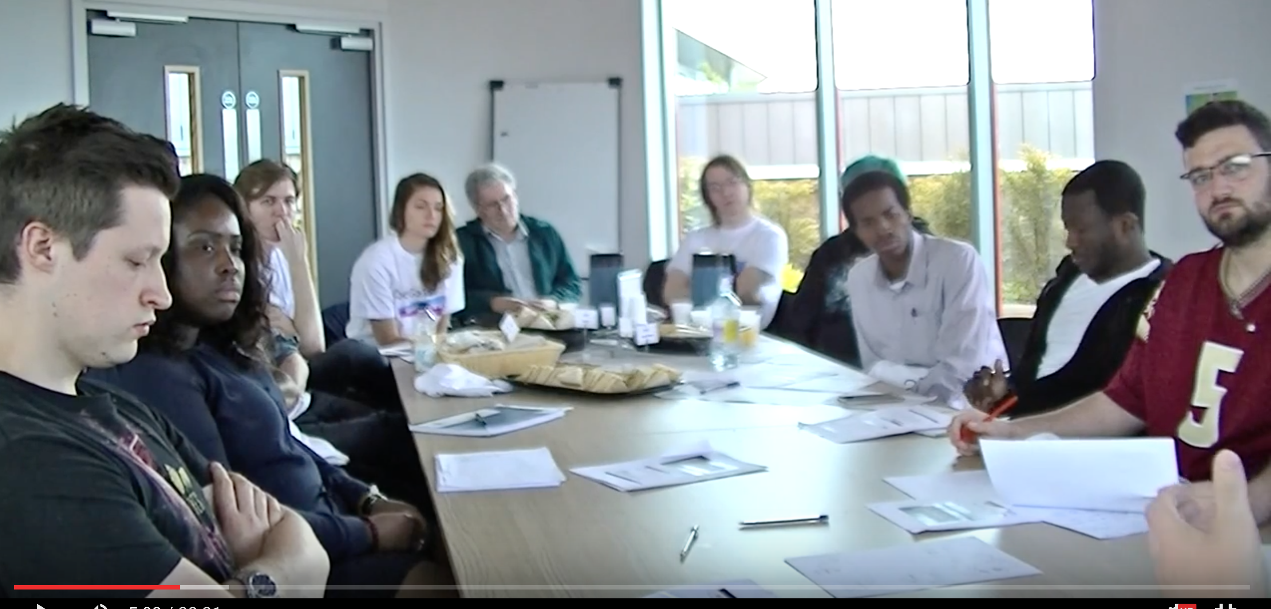
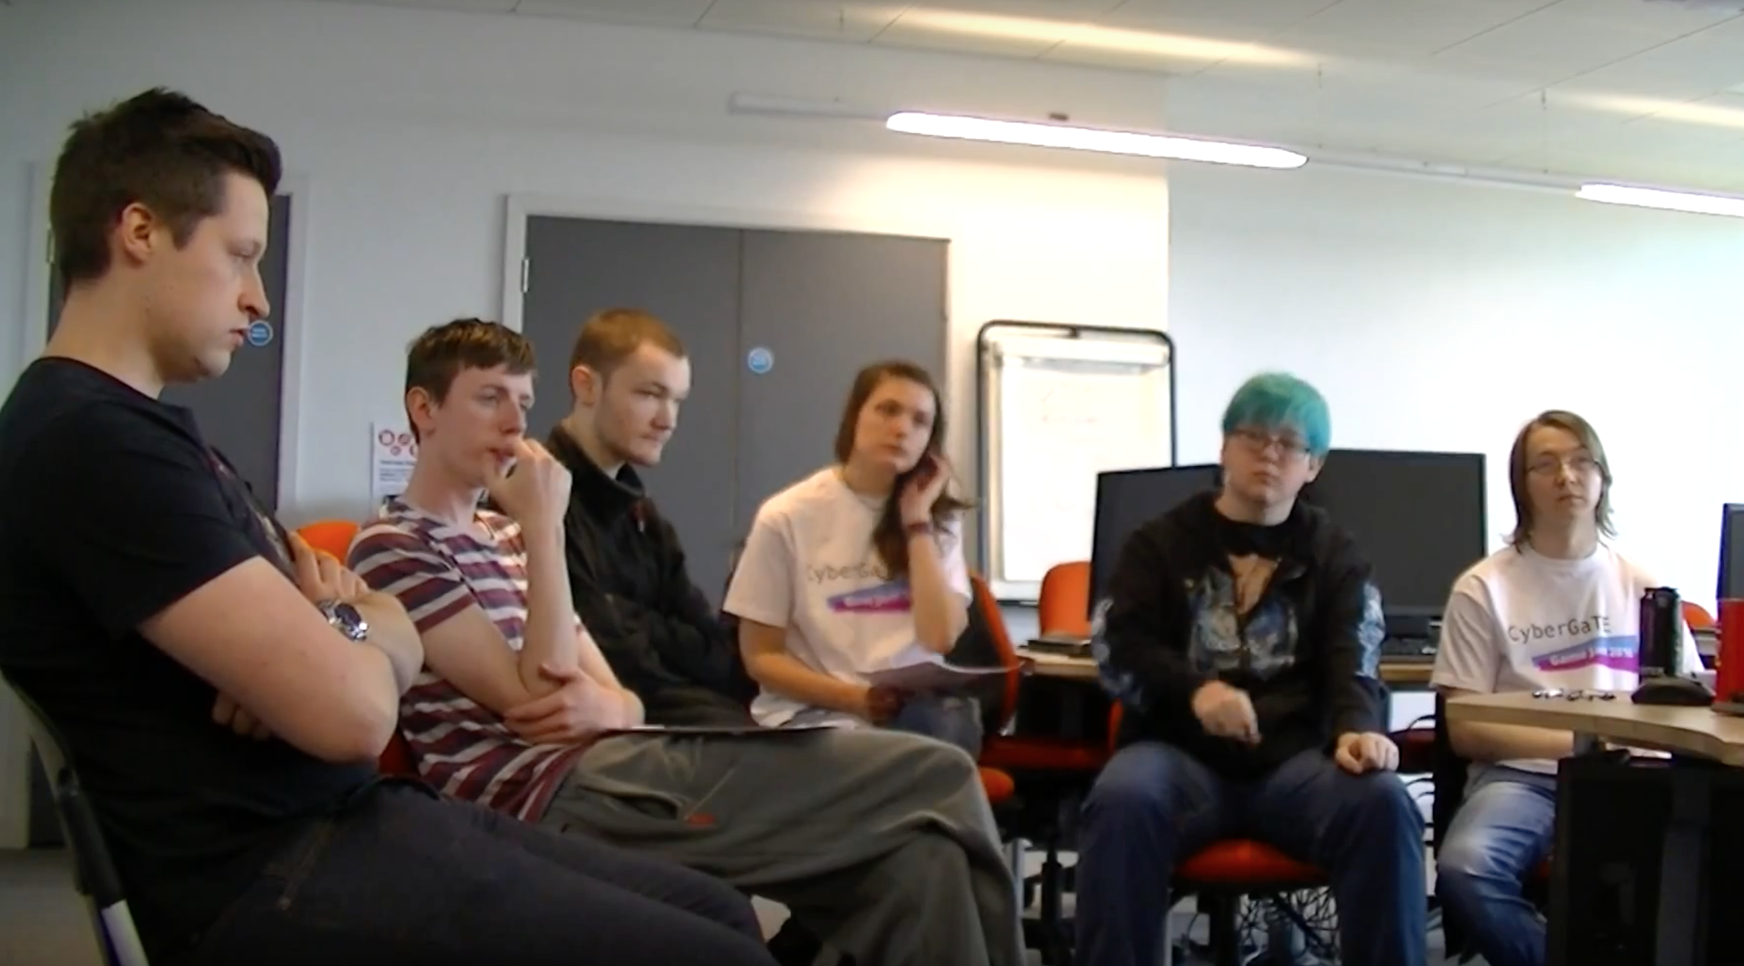
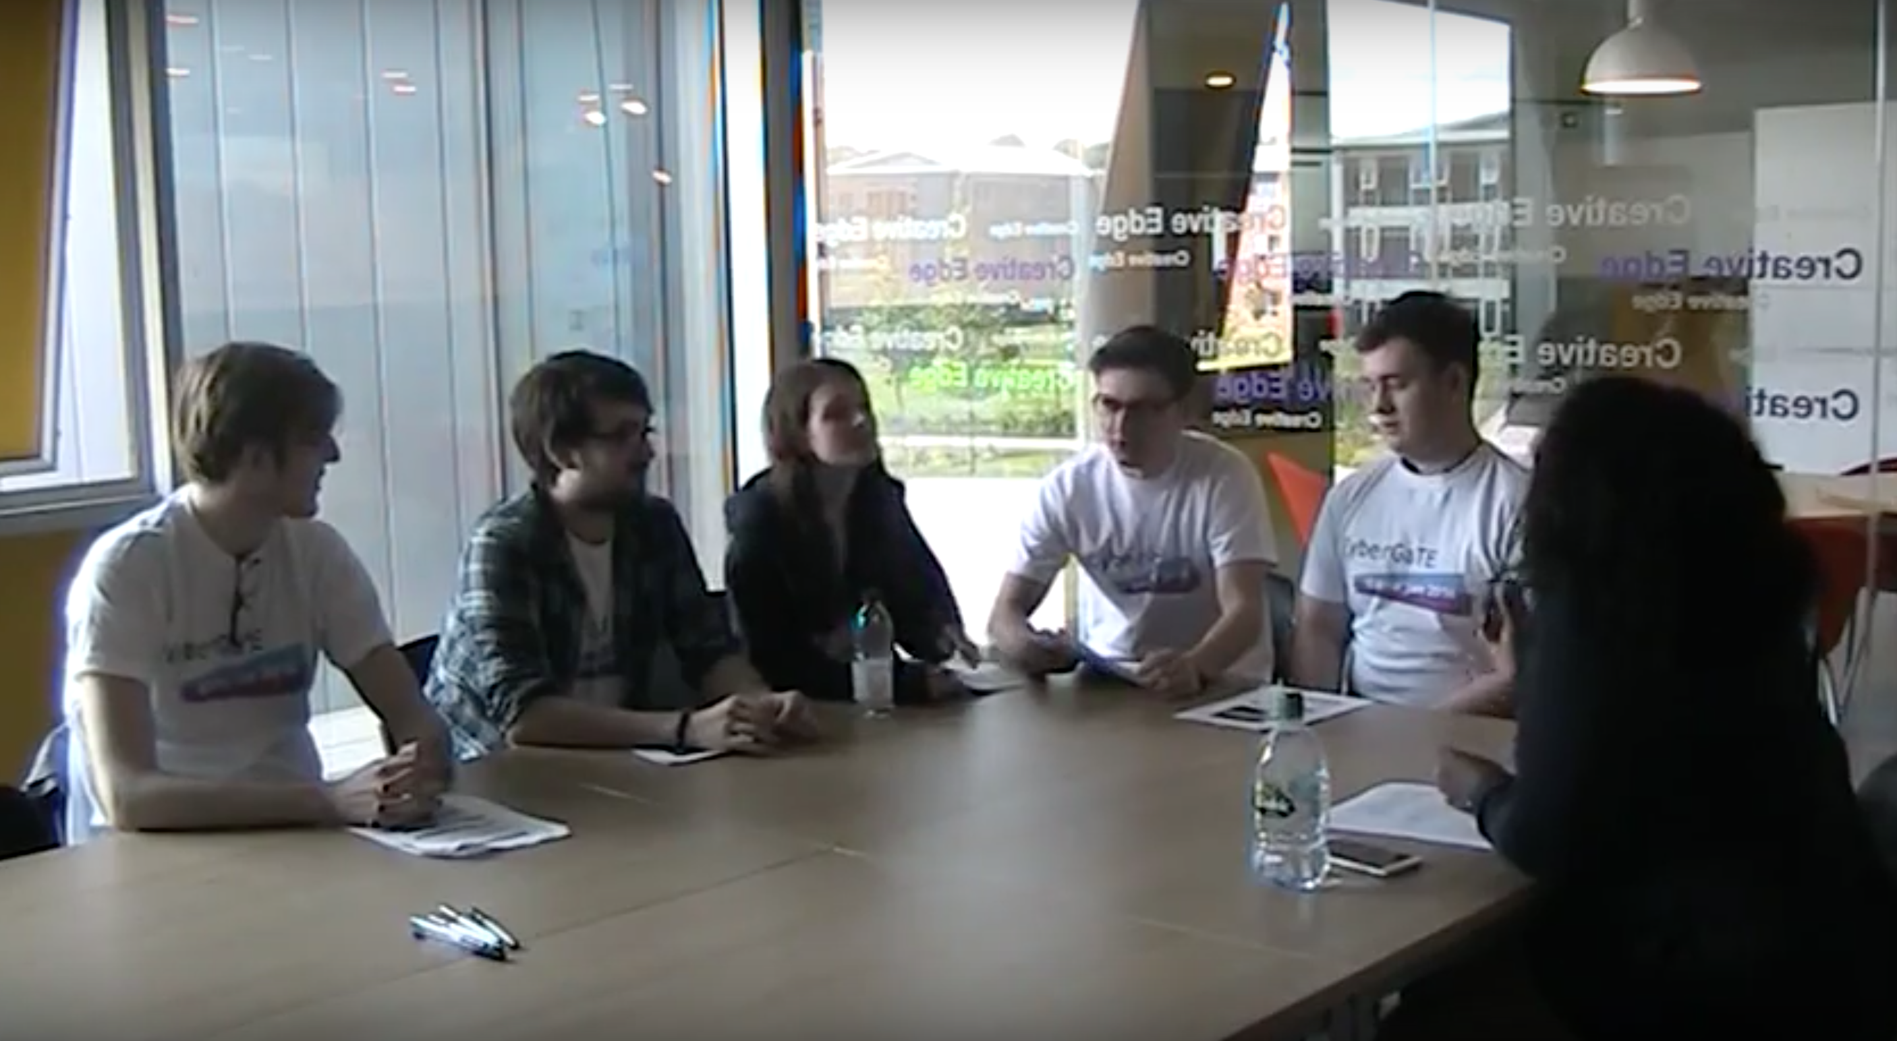

Slide 18
Pilot Lesson Plan
A pilot lesson plan was designed with the following learning objective
At the end of this session the students are expected to be able to
Articulate the various cyber-security terminologies and identify them in a given cyber-security scenario
Understand the layers of cyber security and articulate the role each layer plays in designing a holistic cyber-security solution.
Identify the types of security attacks.
Understand and Appraise the goals of security.

Slide 19
Results
The GameJAM recordings were analyzed and the outcome listed
Tower defence Strategy - is a type of strategy game where the goal is to defend a player's territories or possessions by obstructing enemy attackers, usually achieved by placing defensive structures on or along their path of attack (Learn by Failing)
Attack-Strategy –is a type of games focus on gameplay requiring careful and skillful thinking and planning in order to achieve victory. (Think Like a Hacker)
Puzzle - require the player to solve logic puzzles or challenges to navigate through complex layers of a game.(Problem-Solving)
Role-playing - Most of these games cast the player in the role of one or more "adventurers" who specialize in specific skill sets (such as melee combat or casting magic spells) while progressing through a predetermined storyline. (Student Engagement)

Slide 20
Future Work
Workpackage 3: Implementation
Student project assistants have been recruited and trained to start building the game and the virtual lab environment
Workpackage 4: Field Trial Evaluation
The content will be field trialed across three Modules each at Level 5, Level 6 and Level 7 to evaluate the CyberGaTE content and training envrionment.

Slide 21
Conclusion
CyberGATE aims at using gamification to enhance students engagement with the CyberSecurity material
The resources will be delivered using the concept of classroom as a service
A GameJam has ben held to allow the students to brainstorm on possible game scenarios to be used for the gamification
The gamified resources are under development an will be tested in the coming Autumn

Slide 22
References
[1] ISACA (2015), 'Global Cybersecurity Status Report', [Available Online] http://www.isaca.org/pages/cybersecurity-global-status-report.aspx as accessed on 12th October 2015
[2]H M Government (2014), 'Cyber Security Skills - Business perspectives and Government’s next steps', [Available Online] https://www.gov.uk/government/uploads/system/uploads/attachment_data/file/289806/bis-14-647-cyber-security-skills-business-perspectives-and-governments-next-steps.pdf as accessed on 12th October 2015
[3] Bada, M., Sasse, A., & Nurse, J. R. (2014). Cyber Security Awareness Campaigns: Why do they fail to change behaviour?. Report). Global Cyber Security Centre.
[4] Klopfer, E., Osterweil, S., & Salen, K. (2009). Moving learning games forward.
[5] Adams, M., & Makramalla, M. (2015). Cybersecurity Skills Training: An Attacker-Centric Gamified Approach. Technology Innovation Management Review, 5(1).

