Slide 1
Gamified Virtual Training Environment for Cyber-Security Skills Development
Dr. Chitra Balakrishna
Senior Lecturer, Edge Hill University

Slide 2
Agenda
Need for Change in Cyber Security education
CyberGaTE - Project Aims and Objectives
Why Gamification?
The Gap
Work in Progress
GameJAM
Results

Slide 3
Motivation
Based on two important studies ISACA (2015) and H M Ministry of University and Science(2014).
There is a clear shortage of cyber security professionals within UK, while the cyber-threats are on an exponential increase.
Despite the fact that most of the 130 Universities in UK offer some form of cyber security courses.
Fresh graduates lack real-world skills that employers demand
Employers value experience more than academic qualifications.
Notes:
The motivation for this project stems from two important studies conducted by ISACA in 2015 and HM in 2014. These studies established certain facts, yes it is true that there is a clear shortage of cyber security professionals within UK while there is a steady increase in cyber threats leaving most of our businesses under-prepared and more vulnerable to threats. This despite the fact that there have been a steady increase in number of cyber security related courses being offerd at various universities across UK for a few years now.
The study also identifies the cause for this shortage, the important ones being that the fresh cyber security grads do not possess practical skills that the businesses demand and the businesses value experience more than qualifications.
There is clear gap between what the universities are offering and what the industry needs are.
The study does argue that businesses have to pitchin to bridge this gap by providing more opportunities for individuals to gain that experience/ practical real world skills , for example, through internships and apprenticeships.
It is also essential for the businesses to work with universities to ensure the cyber security content deliverered in university courses indeed meets their needs.
These Cyber-Security Grants by the HEA are an off shoot of this study.
Efforts are also being made to strngthen cyber security as a profession through certified professional programs. In this context the vendor neutral certifications by the International Information Systems Security Certification Consortium ISC 2 have identfied core cyber security domains for professionals with varying experience levels.

Slide 4
The Need for Change in Cyber-Security Education
Cyber-Security needs to be treated as professional Practice
An effective cyber-security training calls for change of behavior that requires more than providing information about risks and reactive behaviors – Instructional Approach
Understanding of how different people perceive risks is critical to effective training.
This involves complementing traditional lectures with active learning experiences
Notes:
If what we are currently doing is not meeting the demands, then that’s reason enough to introspect and bring about the change. Furthermore, unlike other computing streams cyber-security could be regarded as a pratice and
An effective training for cyber-security practice calls for change of behaviour and Changing behaviour requires more than providing information about risks and reactive behaviours [1][2].
Understanding of how different people perceive risks is critical to effective training.

Slide 5
The Gap
Existing cyber-security content merely informs the security requirements, associated threats and defenses, and does not focus on communicating appropriate behavior to become cyber-security professionals.
Most cyber-security teaching methods use defensive strategies, in line with the current dominant practice in cybersecurity which is to react, largely, to attacks and not engage in anticipatory or offensive strategies
There is a general lack of attacker-centricity, the characteristics of attackers are seldom incorporated in training in order to understand these attackers or anticipate their attack.
Notes:
Most cyber-security teaching methods use defensive strategies, in line with the current dominant practice in cybersecurity which is to react, largely, to attacks and not engage in anticipatory or offensive strategies.
There is a general lack of attacker-centricity, the characteristics of attackers are seldom incorporated in training in order to understand these attackers or anticipate their attacks.

Slide 6
CyberGaTE: Objectives
Develop a holistic game-based cyber-security training environment that not only informs but enables appropriate change in learner behavior.
The environment to incorporate various elements of real-life ( Challenge-based, ‘think-like-a-hacker’) scenarios that would have learners as active participants.
Use known characteristics of cyber-attackers to train participants in anticipating an attacker's motivation and behaviour in carrying out certain attacks
The gamified learning resources are to be hosted on a virtual training environment using the innovative concept of ‘Classroom as a Service’
Notes:
The objective of CyberGaTE is to develop a holistic cyber-security training environment that enables the change in learner’s behaviour by making them security conscious for every action they perform in the real-world environment. This would be achieved by:
Creating challenge-based, ‘think like a hacker’ –type learning resources that would be gamified. CyberGaTE aims to use the known characteristics of cyber-attackers to train participants in anticipating an attacker's motivation and behaviour in carrying out certain attacks. This anticipation enhances the creation and application of both offensive and defensive strategies against cyber-attacks.
These gamified learning resources would be hosted on a virtual training environment using the innovative concept of ‘Classroom as a Service’, offering the required hands-on real-world experience.. These scenarios will be live/real-life in the sense of providing active and real time feedback to the learners, on their actions, evaluate them and suggest corrections. In a sense, the learners will be hand-held initially and with increasing learning, they will be evaluated for their actions in the scenarios presented to them for their learning.

Slide 7
Gamification
Applying game mechanics in a non-gaming context
The project aims to address issues of engagement and motivation through the use of game mechanics and serious gamification techniques to ensure learning is not compromised.
Some gaming techniques that shall be explored are real-life problem-based storytelling , use of avatar and role-play.
Notes:
Gamification is defined as applying game mechanics in a non-gaming context; Game players regularly exhibit persistence, risk-taking, attention to detail and problem solving; behaviours that are ideally suited for effective cyber-security training[3]
The project aims to address issues of engagement and motivation through the use of game mechanics and gamification techniques and by selecting the appropriate gamification elements to suit individual learner needs, thereby aiding in a change of behaviour. Some gaming techniques that shall be explored are real-life problem-based storytelling that would form the basis of the training content to keep the learner motivated. Use of characters (avatar/role play) is known to influence behaviour and the use of narrative to create a bond between the learner and the avatar reinforces the learning and enhances engagement.

Slide 8
We are not the first!
Game | Offensive Training | Defensive Training | Environment | Other features
Counter Measure [5] | Yes | None | Simulated | Limited features and content.
CyberCeige[6] | None | Yes | Simulated | Proprietary, limited features and content.
Cyber Nexus[7] | Yes | None | Simulated | Proprietary
Cyber Protect[8] | None | None | Simulated | Proprietary and limited awareness
Netwars[9] | Yes | Yes, Limited | Simulated | Proprietary
Micro Games[10] | None | Yes | Simulated | Proprietary and limited features
StreetHacker [11] | None | Yes | Simulated | Mission-based, limited features
Cypher | None | Yes | Simulated | Multi-player, technical

Slide 9
Problems with the existing Cyber Games
Cyber Games – that are competitive and highly technical.
Most of the games simulate the security features into the game with no access to real-world servers
Puzzle games where hacking is merely a theme rather than part of the core game play
The few that incorporate core gameplay in cyber-security
Very technical and based on shell and no aesthetics
Proprietary and targeted at industry professionals
Most of them either use offensive or defensive strategy none of them use both.
No Collaboration between Trainer-Learner
Notes:
Firslty it is still early st
There are two types , cyber games and competitions that are technical and competitive and do not qualify as training grounds.
Among the cybeer games aimed at training, most of them
These games range from simulations that utilize real applications and exploits to puzzle games where hacking is the theme of the game but is trivial to the core gameplay.
ages ,

Slide 10
CyberGaTE Differentiator
Active collaboration between the content producer and consumer. Students as Pro-Sumers
Balance of defensive-offensive strategies within the cyber-games
Free and open source for educational use.
While providing realistic-environment on which to practice the technical skills, CyberGaTE aims to provide a guided learning environment. (Inform and Practice)
Most important is the game is not simulated, instead game is hosted on a virtual training environment with access to servers, firewalls at the backend.
Notes:
Our project draws upon theses ideas of a game with real security concepts, mission-based objectives, and gameplay-type incentives to both inform and provide practice for computer security.
While these sites provide realistic environments on which to practice, most do not provide guidance or advice on how to proceed. provides a guided learning environment.

Slide 11
Learning/Game
Mode
Game
Objective
Virtual Lab
Browser
CyberGaTE Gaming Area

Slide 12
Content Capture
Employers, Domain Experts, Industry Partners
Which of the cyber-security skills is hard to find among fresh graduates or young professionals ?
Academics, Cyber-Security Training Professionals
Which of the cyber-security skills is complex to teach w.r.t student engagement
and learning experience ?
Students
Which of the cyber-security skills were complex to understand and apply either due to lack of engagment or due to complexity?

Slide 13
Survey, Workshop and Interviews
Employers identified cyber-security skills that were hard to find among fresh cyber security graduates
https://docs.google.com/forms/d/17vLR9OT6CaJmoA-Ev7xhmiy6IS5aAPQI4UgjxOO-XSM/viewanalytics (20 industry respondents)
Academics identified cyber-security areas that were challenging to teach based on student performance and student learning experience (16 academics/ Trainers on email survey, workshop)
Students identified cyber-security areas that were difficult to understand and apply due to the lack of hands-on experience or due to the complexity of the topic ( 48 respondents across L5, L6, L7) https://docs.google.com/forms/d/1uwr2Cpj9PWLQcwbiWXd7SF04iXpKOmls9K_7mgg58YI/edit?ts=574d6669#responses

Slide 14
Four broad areas of Cyber Security Identified
Penetration Tests and Ethical Hacking
Intrusion Detection and Monitoring
Incidence Response and Management
Implementing Secure Systems

Slide 15
Gamification
GameJAM - A Focus-group activity with heterogeneous group of students.
The students were given a brief talk on cyber-security and a pilot lesson plan and asked to provide idea for possible games that would deliver the learning objectives
Participant profile
Level 4, level 5, level 6, level 7 as well as PhD scholars, included gamers as well as non-gamers
Both male and female students from various backgrounds, age group between 20-28 years
The gamers played different genres of games with varying expertise and frequency
The Game JAM was facilitated by the students themselves and the outcome of the barnstorming reported to everyone at the end of the GameJAM.

Slide 16
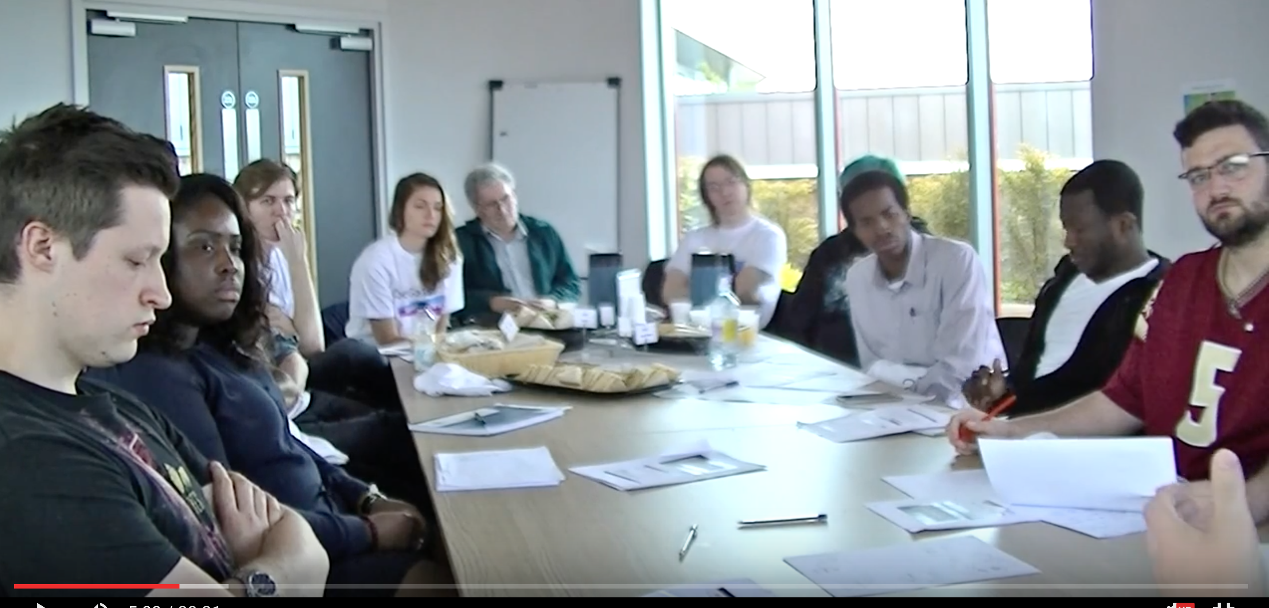
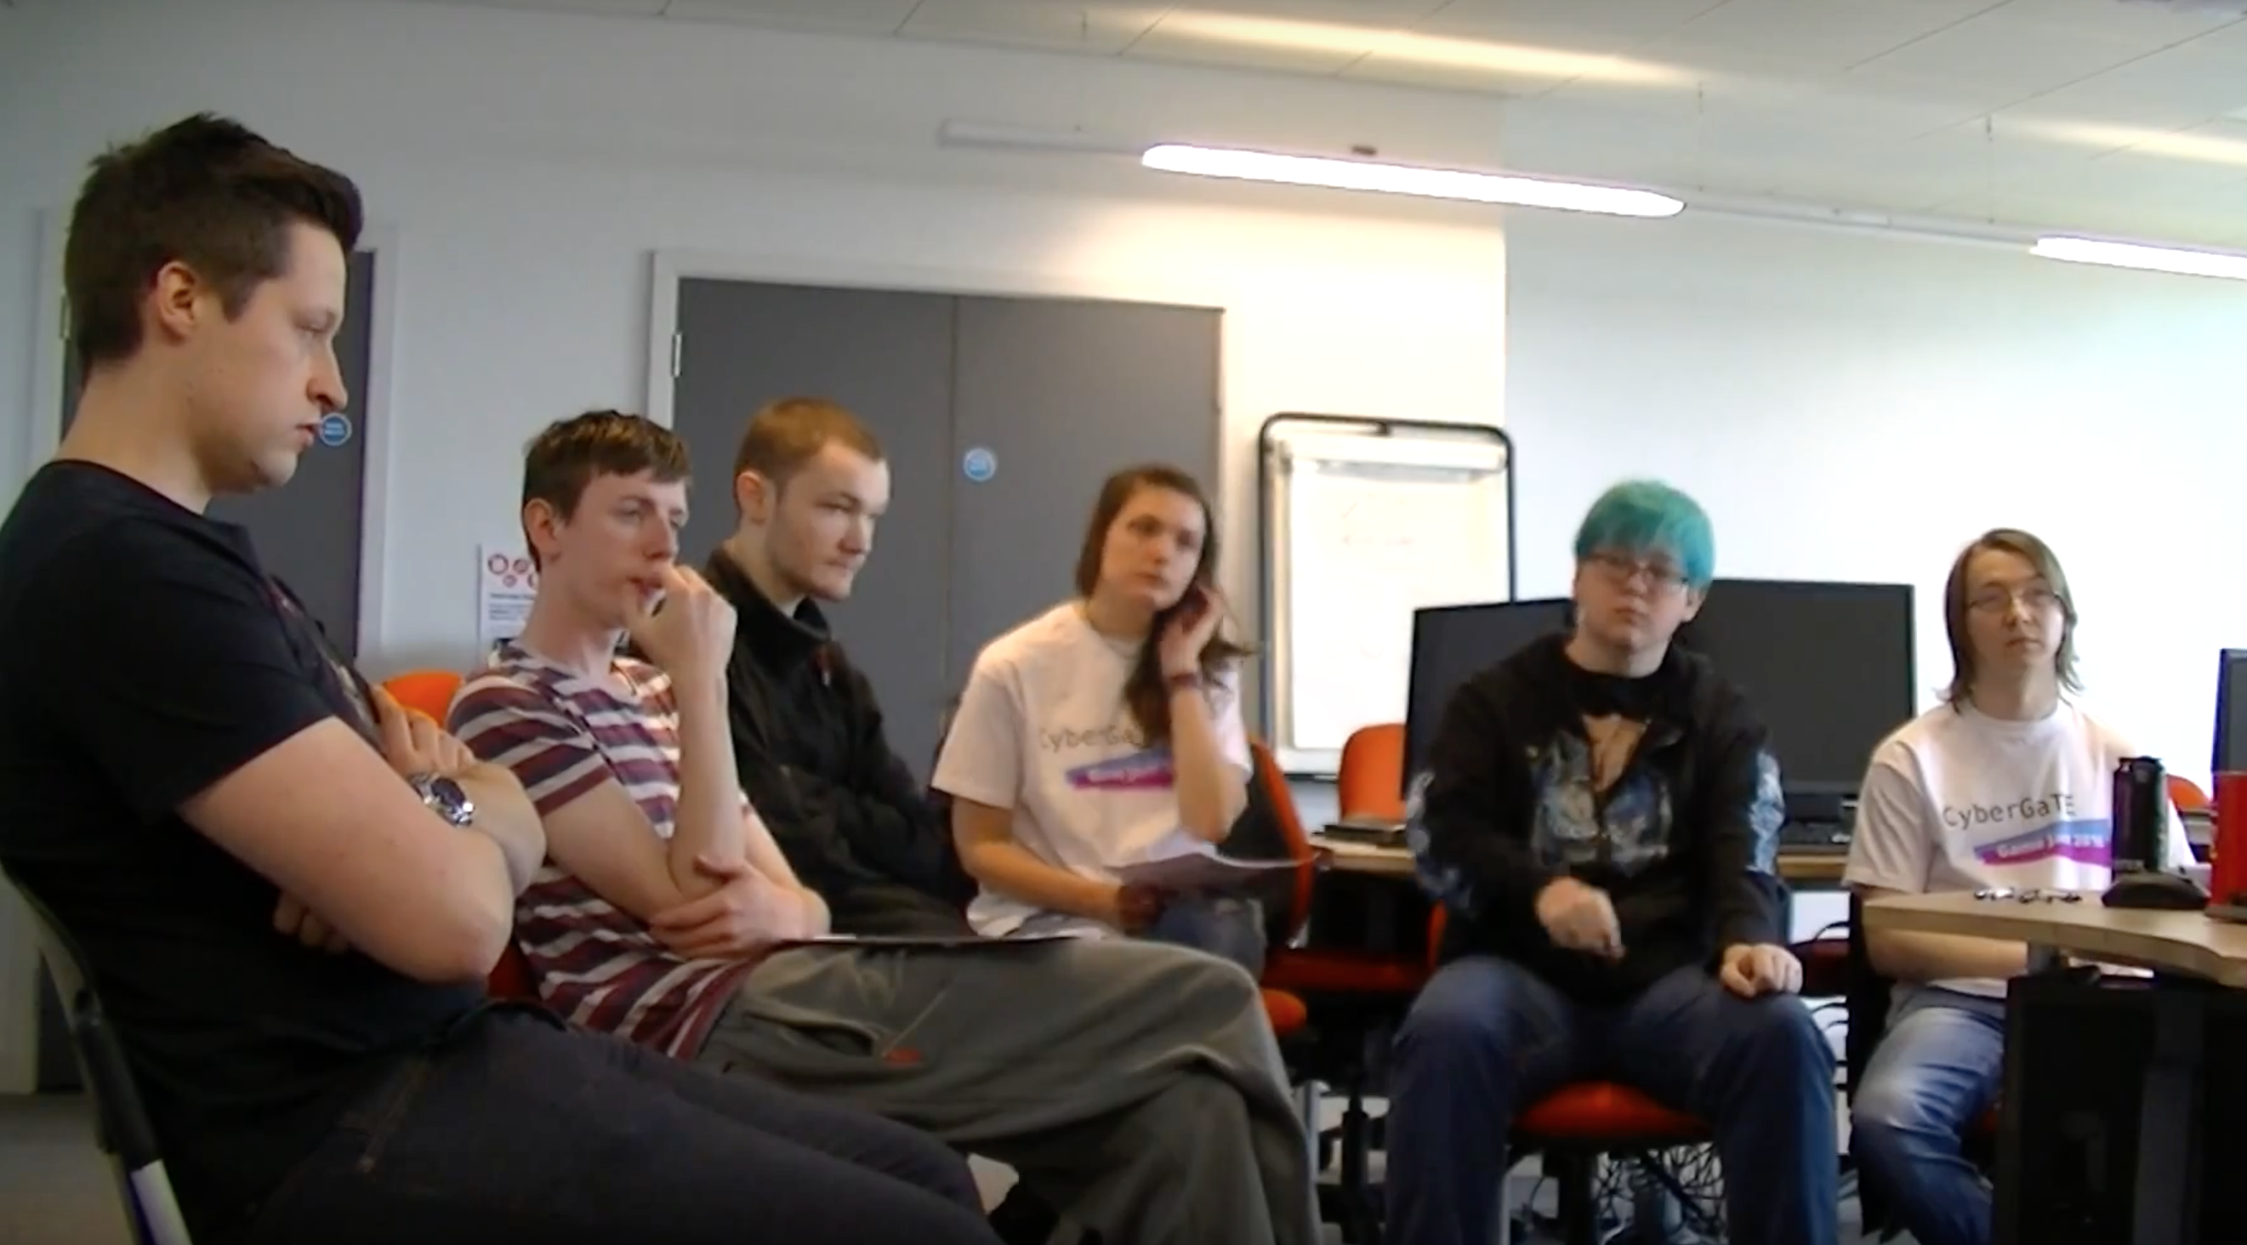
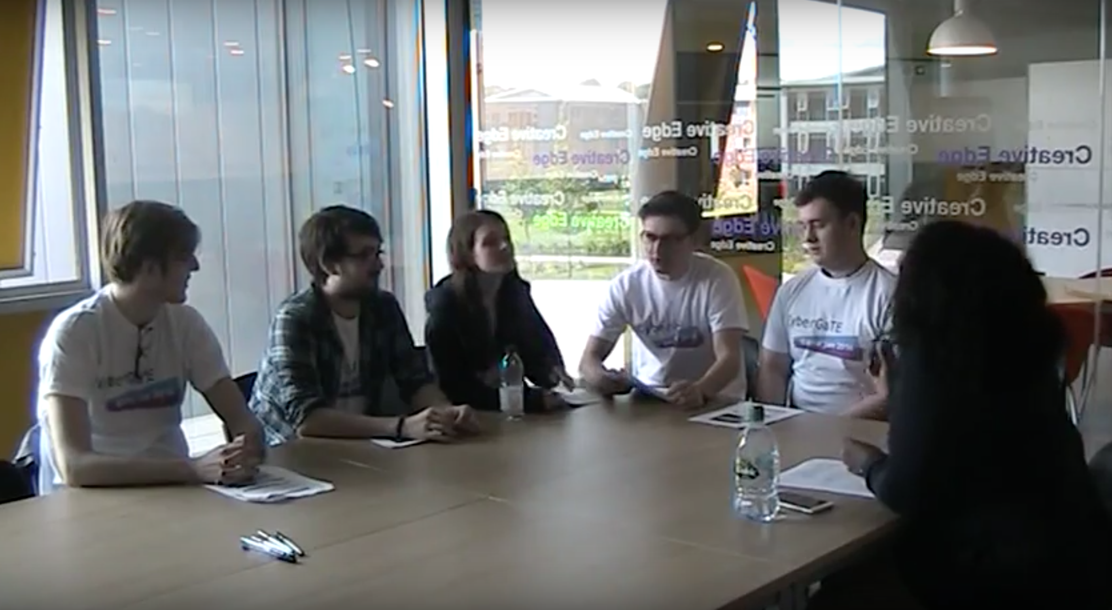

Slide 17
Pilot Lesson Plan
A pilot lesson plan was designed with the following learning objective
At the end of this session the students are expected to be able to
Articulate the various cyber-security terminologies and identify them in a given cyber-security scenario
Understand the layers of cyber security and articulate the role each layer plays in designing a holistic cyber-security solution.
Identify the types of security attacks.
Understand and Appraise the goals of security.

Slide 18
Results
The GameJAM recordings were analyzed and the outcome listed
Tower defence Strategy - is a type of strategy game where the goal is to defend a player's territories or possessions by obstructing enemy attackers, usually achieved by placing defensive structures on or along their path of attack (Learn by Failing)
Attack-Strategy –is a type of game that focus on gameplay requiring careful and skillful thinking and planning in order to achieve victory. (Think Like a Hacker)
Puzzle - require the player to solve logic puzzles or challenges to navigate through complex layers of a game.(Problem-Solving)
Role-playing - Most of these games cast the player in the role of one or more "adventurers" who specialize in specific skill sets (such as melee combat or casting magic spells) while progressing through a predetermined storyline. (Student Engagement)

Slide 19
Future Work
Workpackage 3: Implementation
Student project assistants have been recruited and trained to start building the game and the virtual lab environment
Workpackage 4: Field Trial Evaluation
The content will be field trialed across three Modules each at Level 5, Level 6 and Level 7 to evaluate the CyberGaTE content and training envrionment.

Slide 20
Conclusion
CyberGATE aims at using serious gamification to enhance students engagement and motivation
Balance offensive-defensive strategies in content
CyberGaTE will both inform as well as offer practice of cyber-security skills and will be delivered using the concept of classroom as a service.
A GameJam enabled the students to brainstorm on possible game scenarios to be used for the gamification.
The gamified resources are under development and will be tested in the Autumn term 2016-2017

Slide 21
References
[1] ISACA (2015), 'Global Cybersecurity Status Report', [Available Online] http://www.isaca.org/pages/cybersecurity-global-status-report.aspx as accessed on 12th October 2015
[2]H M Government (2014), 'Cyber Security Skills - Business perspectives and Government’s next steps', [Available Online] https://www.gov.uk/government/uploads/system/uploads/attachment_data/file/289806/bis-14-647-cyber-security-skills-business-perspectives-and-governments-next-steps.pdf as accessed on 12th October 2015
[3] Bada, M., Sasse, A., & Nurse, J. R. (2014). Cyber Security Awareness Campaigns: Why do they fail to change behaviour?. Report). Global Cyber Security Centre.
[4] Klopfer, E., Osterweil, S., & Salen, K. (2009). Moving learning games forward.
[5] Adams, M., & Makramalla, M. (2015). Cybersecurity Skills Training: An Attacker-Centric Gamified Approach. Technology Innovation Management Review, 5(1).

